Slide 1
Practice of Computer Vision Lecture 3
TA: Wonjong Jang

Slide 2
Pretrained Model
resnet18

Slide 3
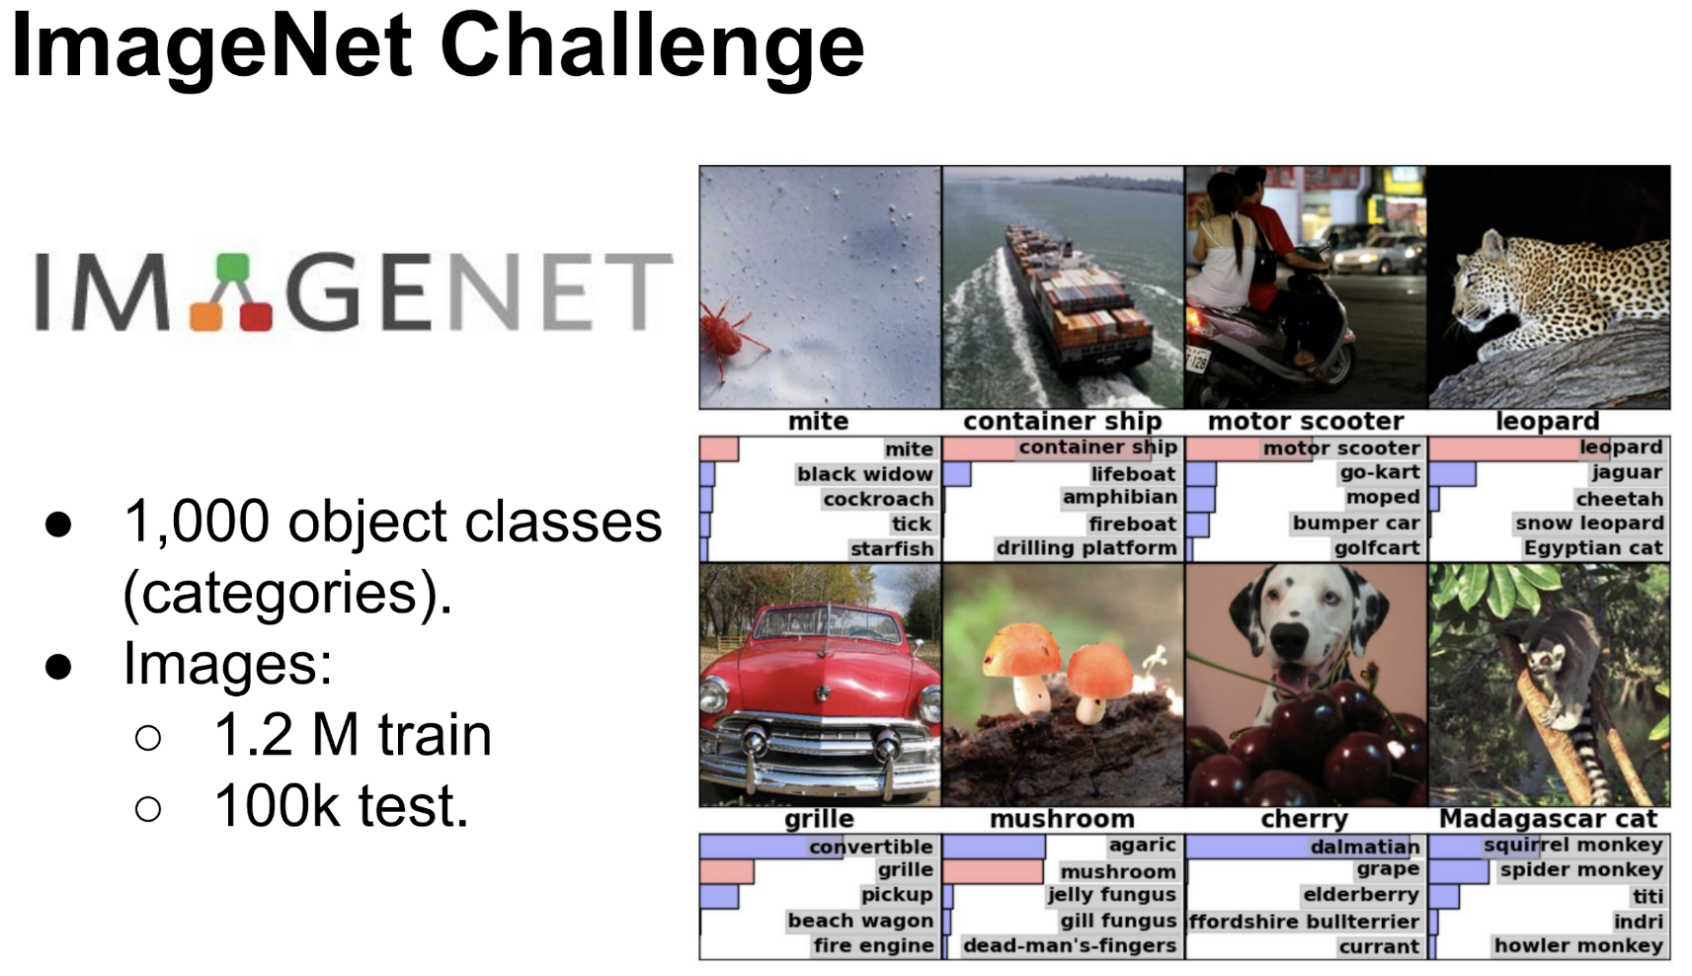
Pretrained Model
http://www.image-net.org/

Slide 4
Pretrained Model
Why is it introduced?
Nowadays, many deep neural network (DNN) can solve vision tasks.
Normally, a deeper NN can perform better than less deep one.
Moreover, many researches show we can use DNN for extracting visual feature.
Fortunately, Pytorch provide many useful DNN for us ☺
https://pytorch.org/docs/stable/torchvision/models.html

Slide 5
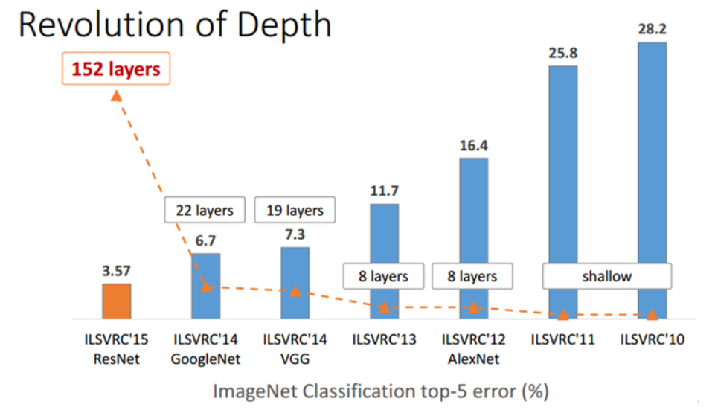
Pretrained Model
Resnet family

Slide 6
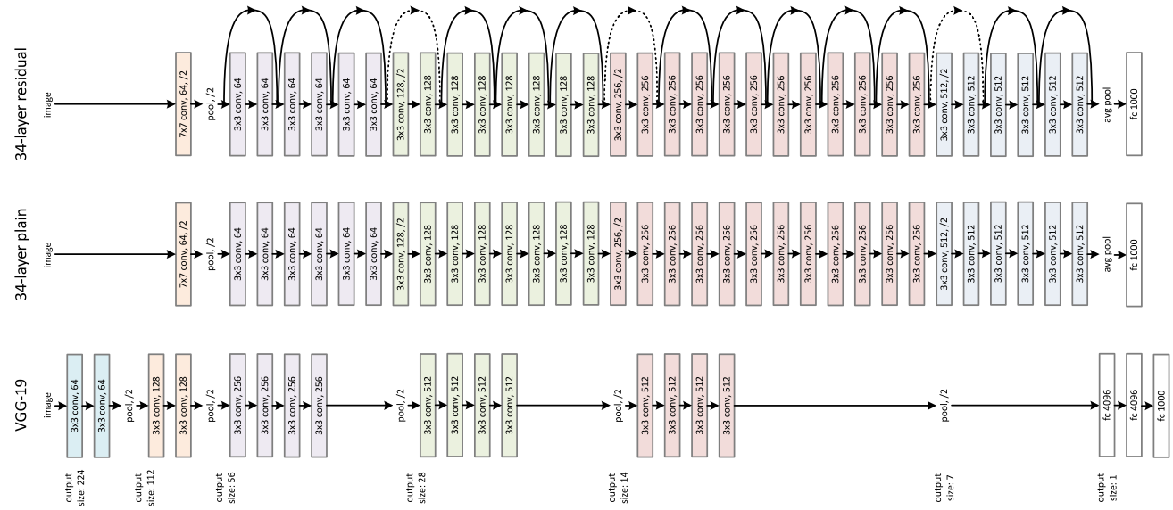
Pretrained Model
Resnet family

Slide 7
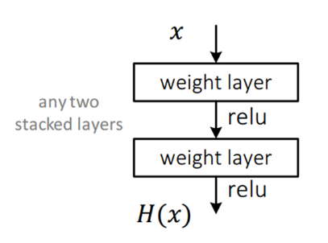
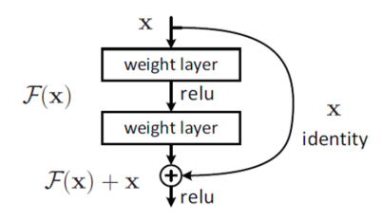
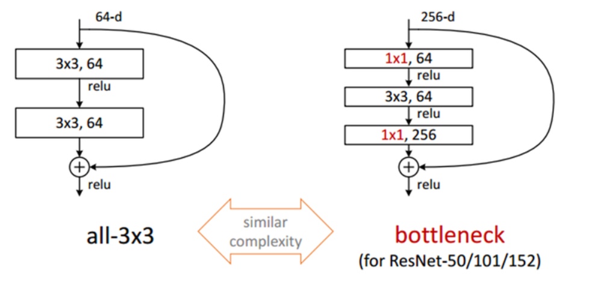
Pretrained Model
Residual module
Bottleneck module

Slide 8
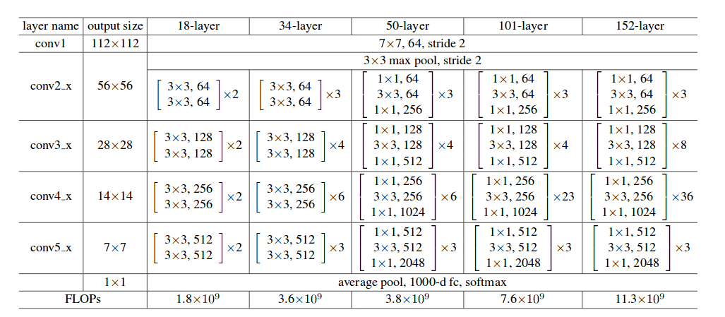
Pretrained Model
ResNet family

Slide 9
Thanks

